Slide 1





PROJECT TITLE
Intelligent University Management System for Students
FULL NAME/ SUBMITTED BY : ANINDA SAU
Registered E-mail on AICTE : anindasau@gmail.com
IBM SkillsBuild Platform e-mail ID : sauaninda04@gmail.com
COLLEGE NAME : THE NEOTIA UNIVERSITY
PHN NO : 6290972423

Slide 2


Introduction
Modern universities face a high volume of student queries across admissions, academics, scholarships, welfare, and career support.
Students often struggle to find the right department, causing confusion and delays.
Our solution: an AI-powered Intelligent Assistant Management System to guide students efficiently.

Slide 3

Problem Statement
Students experience delays due to manual help desks and limited staff.
Peak periods like admissions or exams worsen the problem.
Misrouted queries lead to repeated visits and administrative burden.

Slide 4
Sustainable Development Goal
SDG 4: Quality Education
Ensures inclusive and equitable access to information.
Our system improves access to academic and administrative support, enhancing the learning experience.

Slide 5
Proposed Solution
1
2
3
4
AI-powered virtual assistant for university students.
Understands natural language (text) queries of students.
Automatically routes queries to the correct university unit and direct email to Unit In-Charge.
Functions 24/7 without human intervention.
Provide instant, accurate guidance
Reduce dependency on manual help desks
Minimize student waiting time and confusion
Optimize administrative workload
Improve overall student experience
Objectives :

Slide 6
Key Functional Units
1
2
Admission/Scholarship Unit: Handles admissions, eligibility, fees, scholarships.
Academic Support Unit: Covers curriculum, exams, grading, attendance.
3
4
Student Welfare Unit: Manages wellbeing, hostels, grievances, counseling.
Career/Skill Development Unit: Supports internships, placements, and career guidance.

Slide 7
Target Users
12th pass students seeking admission info
Undergraduate/Post-Graduate students (1st–4th year)
University administrative departments

Slide 8
Technologies Used
Frontend:
React (Vite)
Minimal chat-style user interface
Backend:
Python
FastAPI for API handling
LangGraph for conversation flow and routing logic
AI & Automation:
Gemini API for natural language understanding and intelligent responses
Relay.app for workflow automation and webhook handling
Database:
Supabase (PostgreSQL) for secure data storage
Integration:
Webhook-based communication between system components

Slide 9
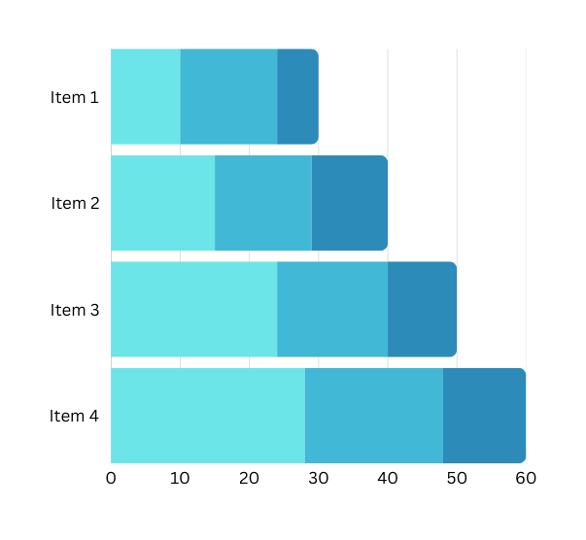
Why It Will Work!
AI understands natural language and routes queries accurately.
Clarification system ensures all required data is collected.
24/7 availability reduces delays and administrative burden.
Scalable and customizable for any university setup.
Notify Unit In-Charge for making arrangement accordings,

Slide 10
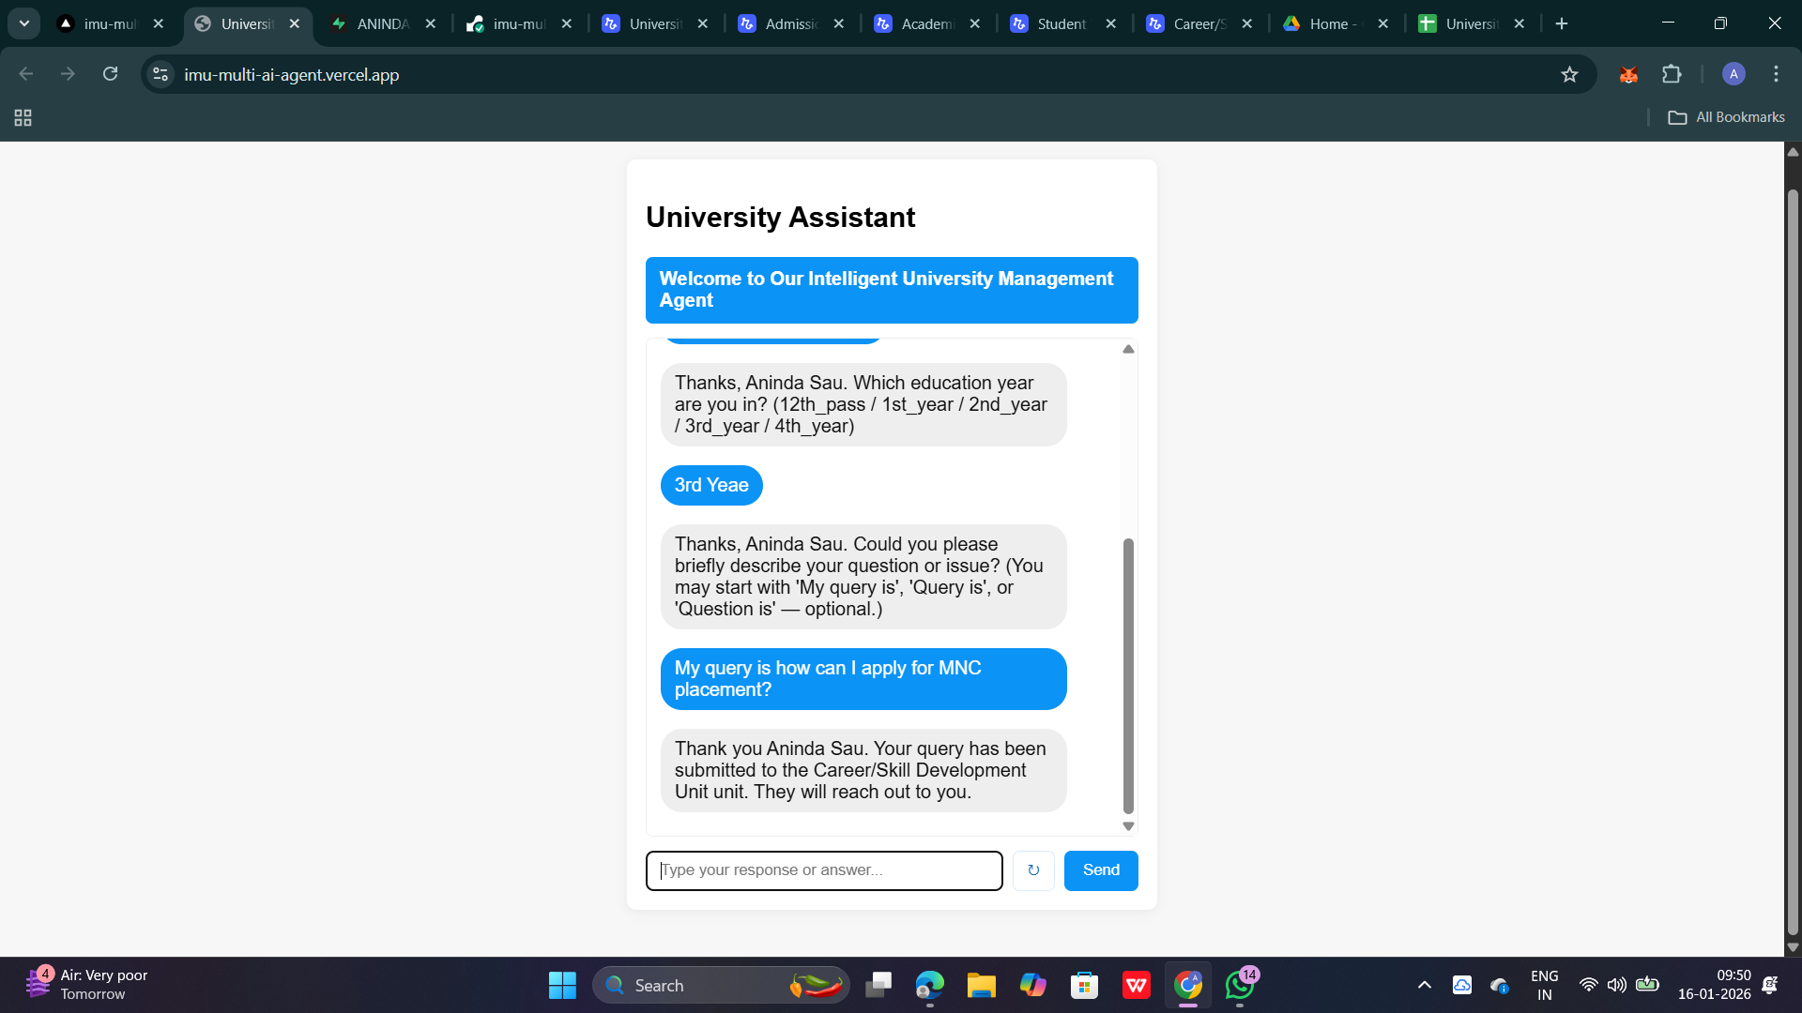
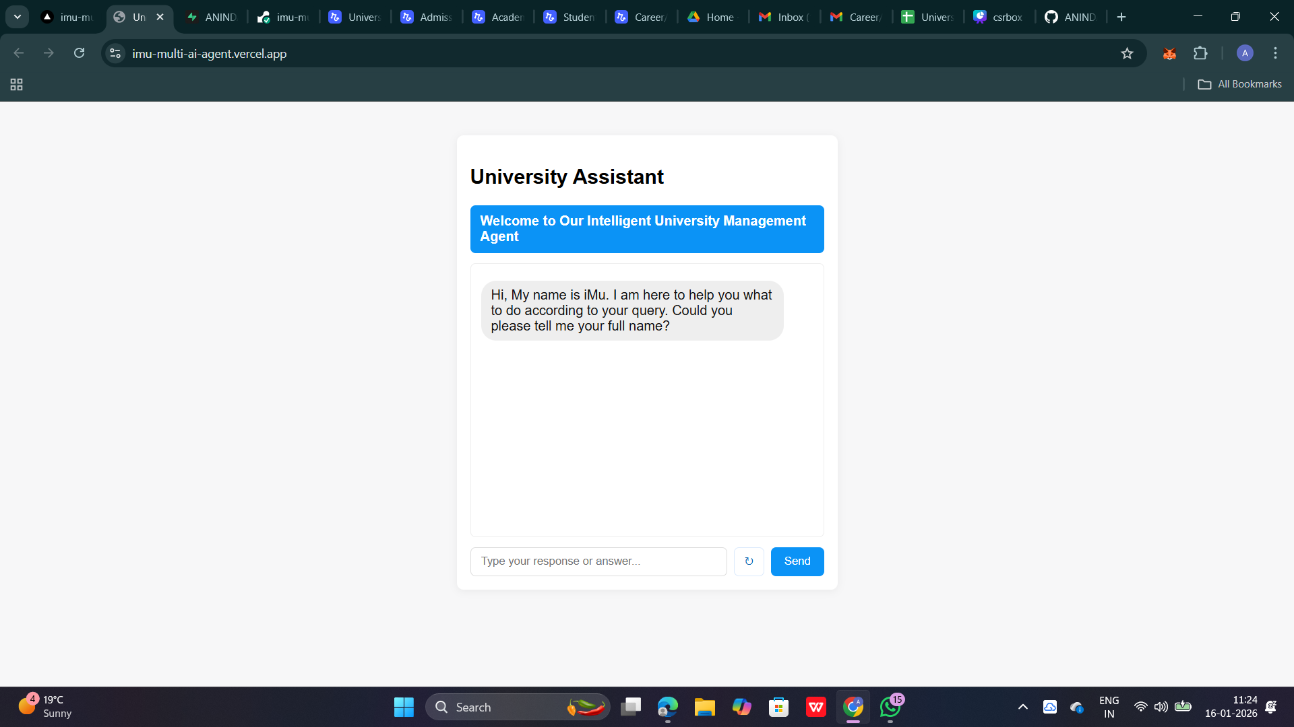
Results / Screenshots
Result-1 : UI

Slide 11

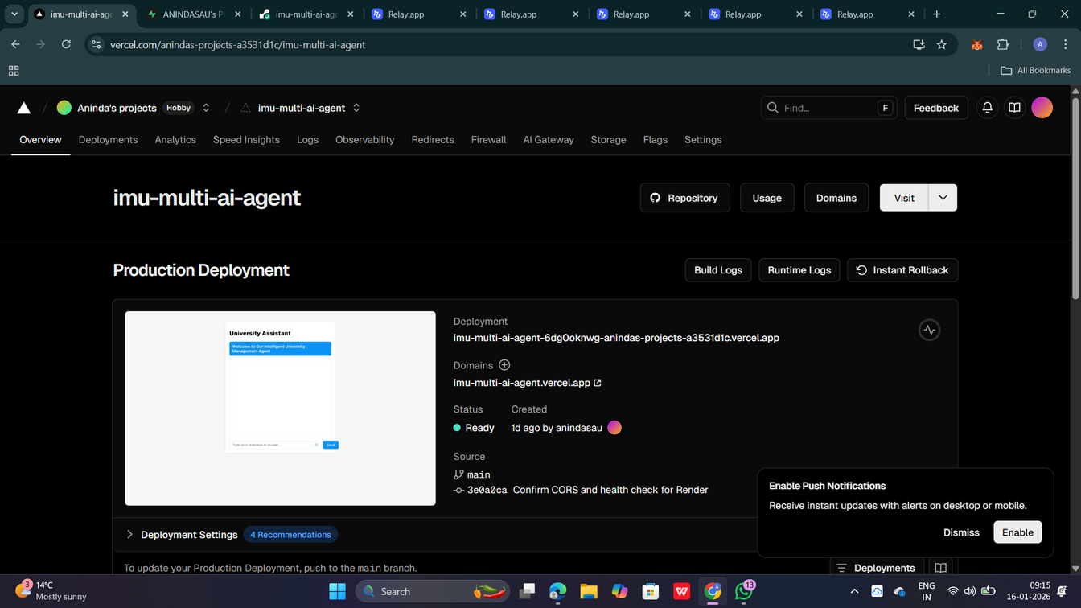

Results / Screenshots
Result-2 :
Frontend Deployment :
Vercel Platform

Slide 12
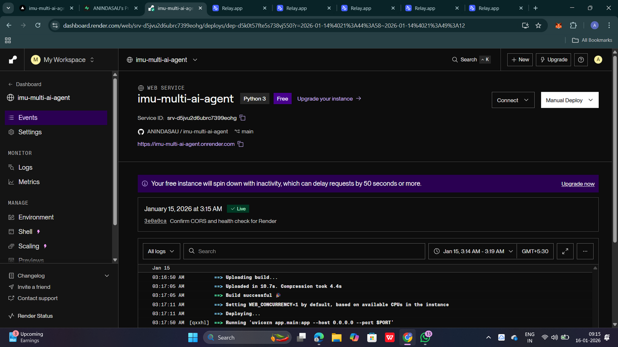
Results / Screenshots
Result-3 :
Backend Deployment:
Render Platform

Slide 13
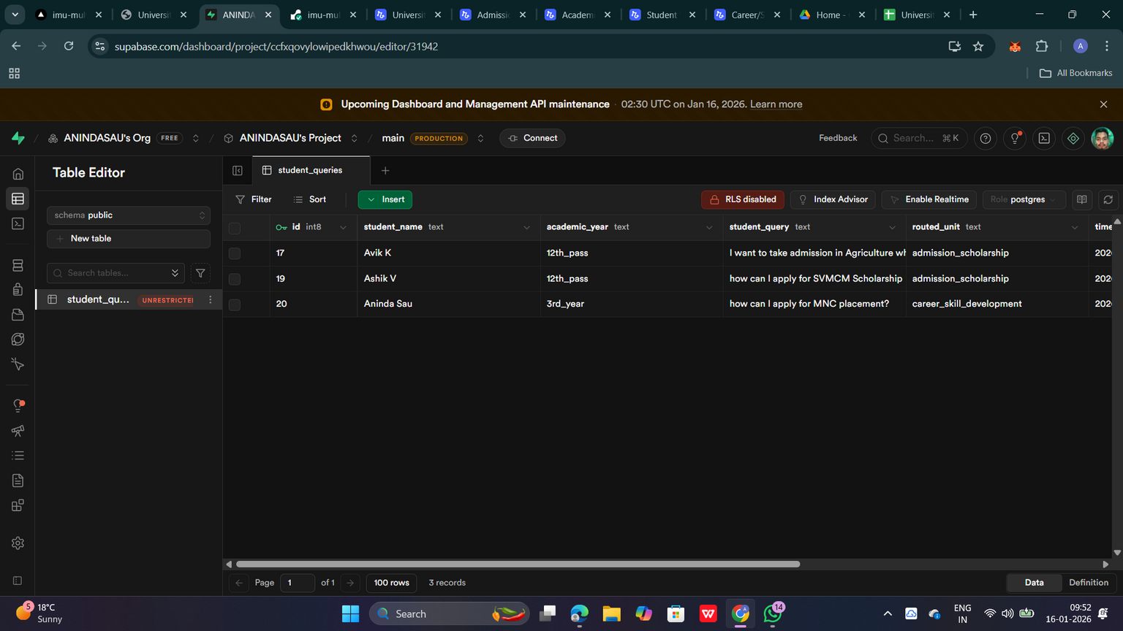
Results / Screenshots
Result-4 :
Database Platform:
Supabase

Slide 14
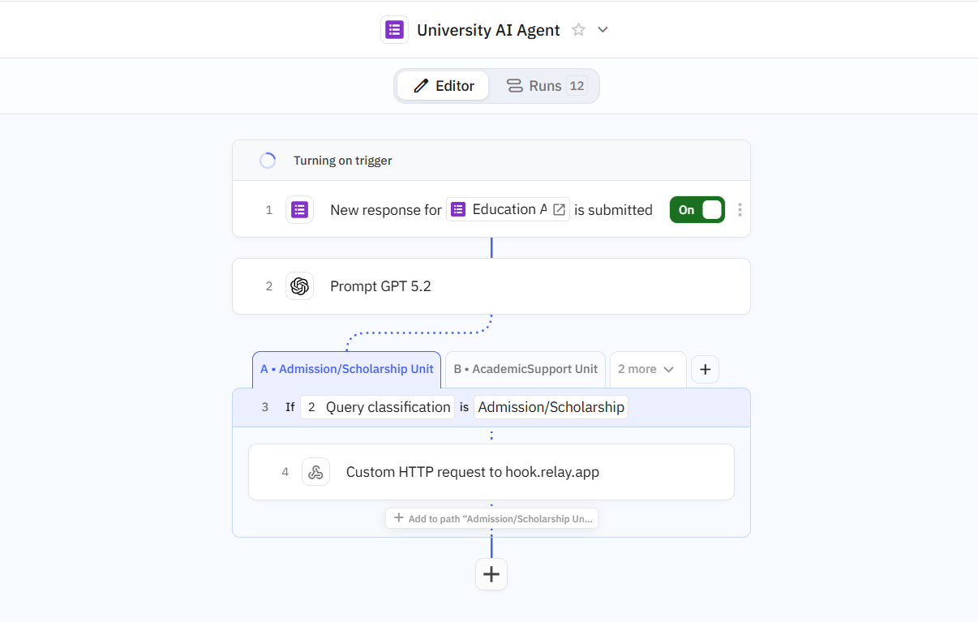
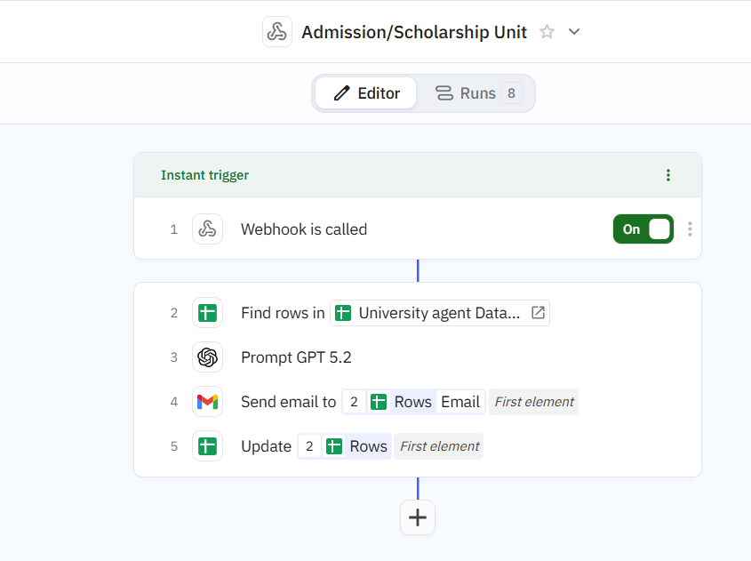
Results / Screenshots
Result-5 :
Multi Agent System:
relay.app
Continue --->

Slide 15
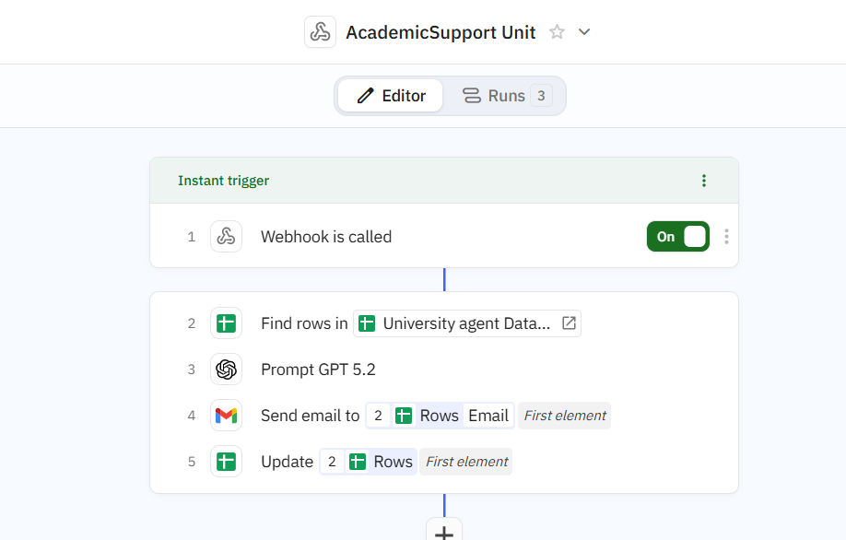
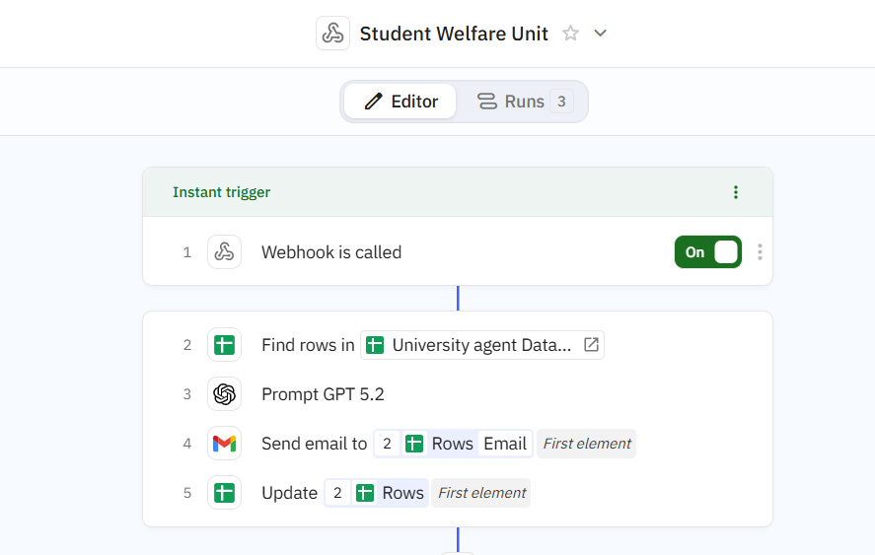
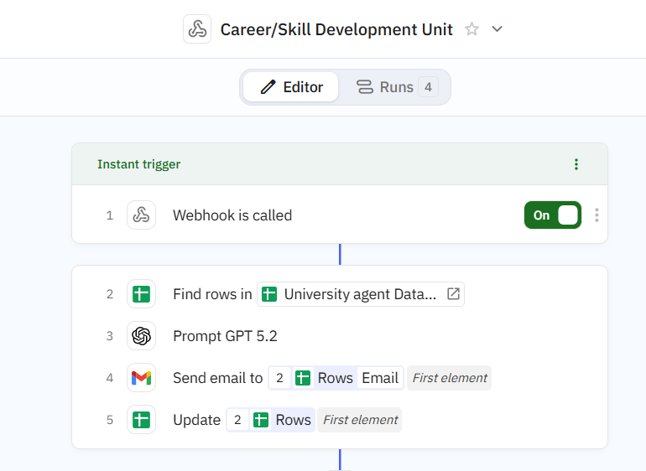
Results / Screenshots
Result-5 :
Multi Agent System:
relay.app

Slide 16
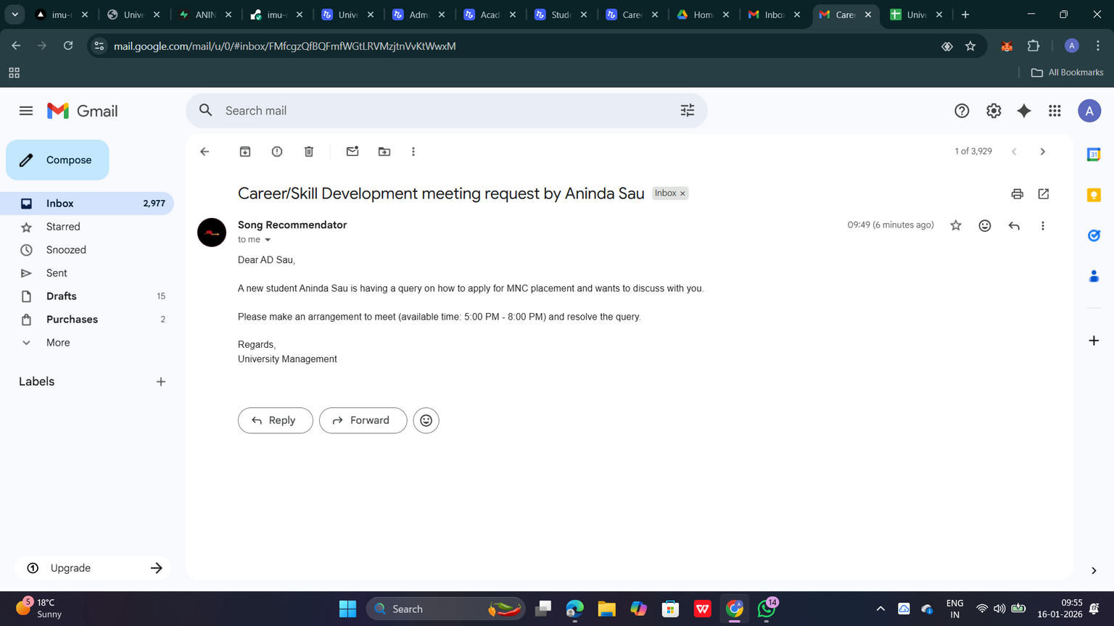
Results / Screenshots
Result-6 :
Email Output:
Gmail

Slide 17
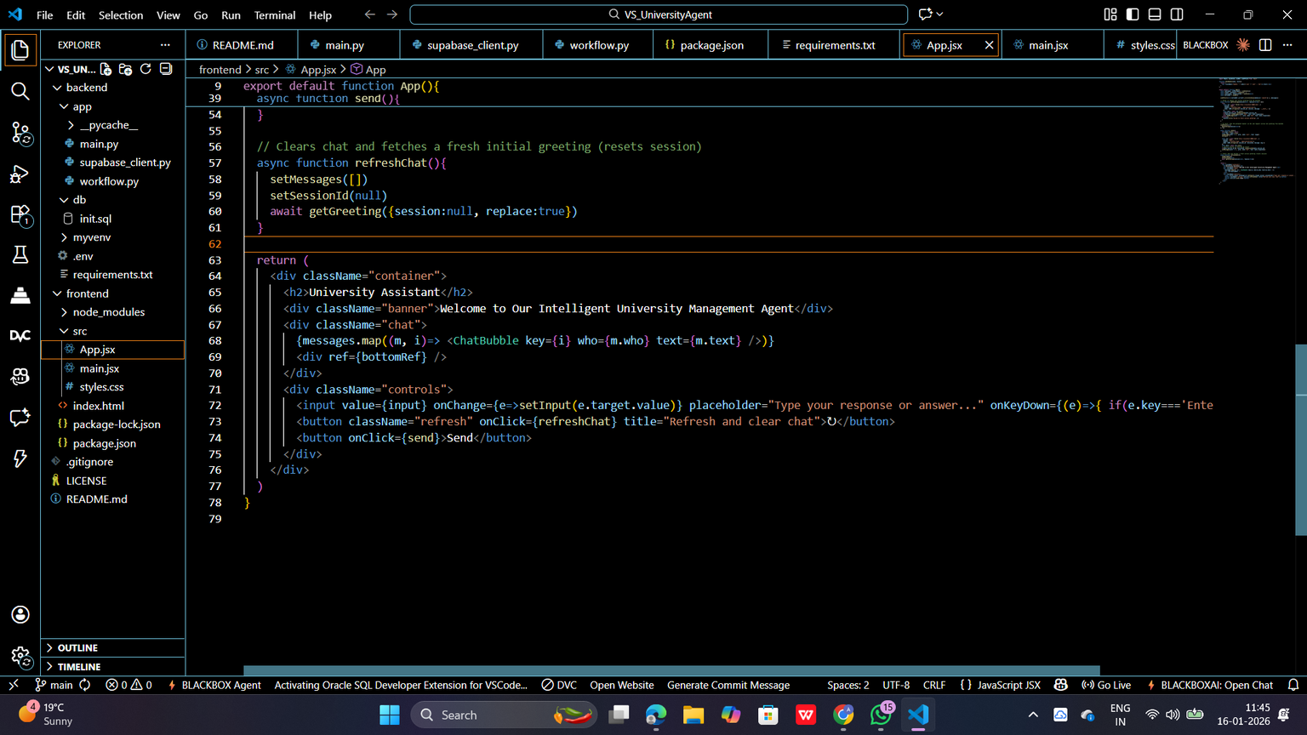
Results / Screenshots
Result-7 :
Code Base:
VS Code

Slide 18




Links
Vercel Link :
https://imu-multi-ai-agent.vercel.app/
https://vercel.com/anindas-projects-a3531d1c/imu-multi-ai-agent
Render Link :
https://imu-multi-ai-agent.onrender.com
Render Link-2 :
https://dashboard.render.com/web/srv-d5jvu2d6ubrc7399eohg/deploys/dep-d5k0t57fte5s738vj550?r=2026-01-14%4021%3A44%3A58%7E2026-01-14%4021%3A49%3A12
Supabase Link :
https://supabase.com/dashboard/project/ccfxqovylowipedkhwou/editor/31942
Github Link :
https://github.com/ANINDASAU/iMu-MultiAI-agent
Drive Link :
https://drive.google.com/drive/folders/1RjznN_l68ItKxF4vhygiKxwKaDwlUg0s?usp=sharing

Slide 19

Conclusion
The system is a scalable, cost-effective solution to university administrative challenges.
AI-driven automation ensures smooth interaction between students and university units.
Enhances access to information and supports Quality Education (SDG 4).

Slide 20
Thank You

